Slide 1
Canyon Ferry Crossing Owners Association Annual Meeting - 2018
9:00 A.M., Saturday, August 4th, 2018 Tri Lakes Fire Station Training Room
Welcome!

Slide 2
Canyon Ferry Crossing Owners Association Annual Meeting – 2018
Agenda
Introduction and Welcome
Meeting Rules
Establish a Quorum (call of roll)
Reading of 2017 Meeting Minutes (reading and disposal of minutes)
Board Nominations (election of directors)
2018 Accomplishments
Reports (reports of officers and committees)
Finance Committee
Architectural Review Committee
Maintenance Committee
Conservation Easement Remediation
Unfinished Business (old and new business)
Contact Information
The Way Forward

Slide 3
Canyon Ferry Crossing Owners Association Annual Meeting – 2018
Meeting Rules (Roberts Rules of Order)
1. For the purpose of recognition, a member at Meetings must (1) Stand, (2) Address the Chair as “Mr. or Madame President”, (3) State their name and (4) Proceed to speak only after recognition by the Chair.
2. Debate shall be limited to two (2) minutes for each speaker, except by two-thirds (2/3) consent.
3. Only fully accredited Property owners shall participate directly or indirectly in a vote on any subject
4. Property Owners that are indebted to the Association, in any amount shall not be seated and cannot vote in the Meetings until such indebtedness is cleared.
5. Nominations from the floor at the Annual Home owners Association Meeting can be made at the time of the meeting. Only one nominating speech shall be made for each candidate and shall be limited to two (2) minutes. Seconding speeches shall be limited to two (2) minutes for each candidate. In the event that more than one (1) candidate is nominated for any one office, the written balloting shall continue until one candidate has received a majority of votes cast by the delegates present and voting.
6. Discussion of personal grievances, local conditions, or claims concerning one (1) individual with respect to their personal interest, shall be in order before this meeting, but must be discussed without repeated unprofessional outbursts, name calling, personal attacks or be subject to removal from such meeting.
7. Please be familiar with the Covenance and Bylaws of the association to save time during meetings of the Home owners Association.
8. Open meetings will be conducted, with Minutes taken and posted on the Website.

Slide 4
Canyon Ferry Crossing Owners Association Annual Meeting – 2018
Quorum
CFCOA Bylaws Section 3.9: “Quorum. The presence of twenty-five percent of the Members of the Corporation, represented either in person or by proxy, shall constitute a quorum”
Number of Eligible Members: 112 total, 28 Needed
Number of Members Present:
Number of Proxy Votes:

Slide 5
Canyon Ferry Crossing Owners Association Annual Meeting – 2018
Reading of 2017 Meeting Minutes (1 of 4)
The Annual Meeting of the Canyon Ferry Owners Association was called to order at 10:00 a.m. at The Dam Bar, on Saturday March 25, 2017 by Scott Millam, President of the Association. Board members present were John Ratliff, Treasurer and Susan Peters, Secretary. Tabulation of the sign in sheets and of the proxies showed the following number of voters out of 107 voting (paying) lots: Voters present 17 Voters present by proxy 16 The total number present was 33 voters and as such a quorum (28 for a quorum) was present for all business to be conducted. Proof of due notice of the meeting was filed and the meeting proceeded. A motion was made to dispense of reading of the minutes due to the amount of time involved. It was seconded and unanimously passed to accept the 2016 annual meeting minutes. James and Mary Fried did not get notified of the meeting so the records will be verified.

Slide 6
Canyon Ferry Crossing Owners Association Annual Meeting – 2018
Reading of 2017 Meeting Minutes (2 of 4)
REPORTS: Financial Report: John Ratliff, Treasurer presented the Financial Report and a Summary of Cash Flow is attached. $68,836 was collected in 2016 for dues and fees. $28, 161 was used for road improvements and repairs. $24, 679 was used for miscellaneous improvements, legal fees and utilities. The Association saved about $5,000 on maintenance due to volunteer maintenance committee. The Association had a $17,000 positive cash flow in 2016. John brought up the issue of a member who is past due on his membership dues and incurring fees and interest. There have been written threats to board members from this individual and he has threatened to sue each board member. It was discussed as to whether the Board should take further legal action. The consensus of the attending members was to go after him aggressively. No motion was needed. A lien has been placed on his property and at this time the amount owed is too high for Small Claims Court. The members wanted to know if the Association had insurance to cover any lawsuits against the Association. The Board was going to find out. Roads and Maintenance: Gary Nelson said this is a volunteer committee who has overhauled the front entrance irrigation system, which required $4,500 in supplies, negotiated a new water contract, replaced fence posts, added river rock and cut down 25 trees on the walking path along with a lot of clean up and repairs to a much neglected landscape and irrigation system. Gary along with Larry Shields and Scott Millam provided many hours of physical labor at no cost to the Association. Members wanted to see if the trees cut down on the pathway could be chipped and put back on the path. The Board will look into it. This year there will be a concentration on spraying the roadways. The old water tanks are abandoned and need to be removed.
ARC: Fran Hovan reported that we have a new application on Lake Point Dr, 3 new developments, 2 property improvements, 1 building additional garage, 1 landscape deposit to return and holding 4 landscape deposits. A member asked if the Ryan house was within the building envelope and Fran confirmed that it was. Fire Department donation was approved again for 2017 in the amount of $1,000.

Slide 7
Canyon Ferry Crossing Owners Association Annual Meeting – 2018
Reading of 2017 Meeting Minutes (3 of 4)
Election of Directors: Scott opened the floor for nominations for the three Director positions that were open. Scott nominated himself, John and Walt Ainsworth. Rory McLeod then nominated Mike Clouse, Jim Ybarrondo, and Rory McLeod as a slate to replace the existing nominees. At this time Mike presented 20 additional proxies that were collected and signed by members that gave Mike the authority to vote their proxies. There was much confusion as to whether we could discuss the new nominees and what the purpose of this new slate was. Mike confirmed it was to replace the existing 3 members. There was much disagreement and contention about what the current board was doing versus what the new slate of nominees wanted done. Mike Clouse wanted it noted that three times inappropriate name calling was directed at Mike and Jim. It has been noted. After an hour and a half of awful, contentious discussion a vote was called for. It was seconded and a written vote was turned in. At that time, Susan and Jim confirmed proxies and counted the vote. The current board slate (Scott, John, Walt) received 26 votes and the new slate (Rory, Mike, Jim) received 27 votes. At that time Scott announced the results and left the meeting along with many members as the new directors came forward. The remainder of the meeting was conducted by the new board members, Rory McLeod, Mike Clouse and Jim Ybarrondo. The new Board’s priorities will be maintenance and paying down debt and Board transparency. It is also the Board’s responsibility to collect dues so they will be aggressively pursuing delinquent members. Jim said there would be no new Association expenditures until the debt is paid off and he is estimating that will be in 2018. The intent of the last increase in dues ($120 increase) was to place that amount into a separate fund to pay for future road construction.

Slide 8
Canyon Ferry Crossing Owners Association Annual Meeting – 2018
Reading of 2017 Meeting Minutes (4 of 4)
New Business: The new Avalanche Irrigation District is a new proposed irrigation/subdivision district on the East Shore of Canyon Ferry Lake by Goose Bay. They are proposing 51 high density water wells that will pull from Canyon Ferry Lake and the aquifer system around the lake. The Board is concerned about how this will affect the wells in our subdivision. There are ongoing meetings and the Board encouraged those that could attend to do so and vote No. The new Board will meet with Gary Nelson to figure out how to proceed with the maintenance going forward. It was motioned, seconded and approved to adjourn the meeting at 1:20 p.m. Jim Ybarrondo, Mike Clouse, Rory McLeod, Susan Peters, Secretary Approval; Move to Except; Yes No Yes, with Corrections

Slide 9
Canyon Ferry Crossing Owners Association Annual Meeting – 2018
Election of Directors
Board Secretary; TJ Hull (2 year term)
Board 2nd Vice; Rod Kessel (2 year term)
Nominations from the Floor for the Board?

Slide 10
Canyon Ferry Crossing Owners Association Annual Meeting – 2018
Accomplishments, Initiatives and Course Corrections
Accomplishments and New Initiatives.
Maintained our promise of transparency by posting all meeting dates, locations and minutes on the Association website.
Paid the $52,000 loan down by $20,000 and positively renegotiated the terms of the loan
Contracted with a tax professional to conduct a third-party review of past finances
Initiated legal action against the owners most delinquent in paying association dues while formally adopting a standard of one-year grace period for members that are having temporary financial difficulty
Undertaken a process to remove the current street lights and replace with solar lighting, saving $350 per month
Developed a “Weed Removal Notice” to be provided to owners that have not mitigated noxious weeds
Started work with the USPS to install refurbished parcel boxes at no cost to the association
Applied for and qualified for a USDA Conservation Program Grant for the conservation easement to mitigate fire hazards, improve aesthetics, reduce noxious weeds, reseed native grasses and improve wildlife habitat in the 37-acre easement

Slide 11
Canyon Ferry Crossing Owners Association Annual Meeting – 2018
Accomplishments, Initiatives and Course Corrections
Accomplishments and New Initiatives (continued)
Affordably sealed all street cracks throughout the Association
Successfully secured repairs in several areas of the neighborhood where asphalt repairs were failing
Established and formalized snow removal standards that balance cost with safety and owner convenience
Made excellent progress with organization of and timely posting of information to the Association website
Removed a number of “improvements” at the entrances to the subdivision that were illegally encroaching on private property.
Made excellent strides in establishing and maintaining accountability of supplies, equipment and property purchased by the CFCOA
Course Corrections
Ended the volunteer work initiative which created significant Association liability
Initiated corrective action to move the maintenance shed from the conservation easement in contravention to the Association CC&R’s
Undertook action to clarify or correct what appears to be improper disposal of the association weed sprayer
Worked hard to consolidate and organize seriously lacking association records

Slide 12
Canyon Ferry Crossing Owners Association Annual Meeting – 2018
Finance Records Review Results
Review of 2013 home owner association records conducted by local tax professional
Findings:
No major issues
Minor issues: contractor being paid fixed sum and other services(resolved), only single signature on association checks(discussed).
No further actions being taken. Cost of formal audit not cost effective for association.

Slide 13
Canyon Ferry Crossing Owners Association Annual Meeting – 2018
Income and Expense Report : Rory McLeod - Treasurer
Jan - Dec 17
Income
Architectural Review Fees 3,000.00 Dues - Other 63,300.00
Total Income 66,300.00
Expense
Insurance 2,572.00
Legal Fees 6,857.90
ARC Expenses 2,133.05
Weed Control 573.75
Landscape Maintenance 660.00
6452 · Maintenance - General 2,013.94
6453 · Maintenance and repairs - other 396.86
Road repairs and maintenance 3,790.00
Snow Removal 3,430.00
Landscape refund 1,000.00
Office Expense 475.93
Donations 1,000.00
Licenses 20.00
Taxes-Property 243.28
Loan principal reduction 39,552.40
Loan Interest 2683.82
Utilities – street lights and pump 4286.42
Other Misc and receipts 913.16
Total Expense 72,791.54

Slide 14
Canyon Ferry Crossing Owners Association Annual Meeting – 2018
2017 Balance sheet
Dec 31, 17
ASSETS
Current Assets
Checking/Savings 21,025.22
Accounts Receivable 6,812.21
Prepaid expenses 440.00
Undeposited Funds 2,100.00
Total Current Assets 30,377.43
Fixed Assets 1301 · Roads 346,644.20
Mail Boxes 5,115.30
Maintenance Equipment 4,092.68
1600 · Accumulated Depreciation 145,895.00
Total Fixed Assets 209,957.18
TOTAL ASSETS 240,334.61
LIABILITIES & EQUITY
Liabilities
Landscape Deposits 6,000.00
Construction loan 20,000.00
Total Current Liabilities 26,000.00
Long-term portion of construction loan 1,858.53
Total Liabilities 27,858.53
Equity
Retained Earnings 198,764.45
Net Income 13,711.63
Total Equity 212,476.08
TOTAL LIABILITIES & EQUITY 240,334.61

Slide 15
Canyon Ferry Crossing Owners Association Annual Meeting – 2018
Architectural Review Committee
CFC ARC Report August 4, 2018
CFC Development Lot Population Summary
Phase | # of Lots | Lots w/ Homes | Percentage
I | 46 | 23 | 50.0%
II | 22 | 7 | 31.8%
III | 35 | 14 | 40.0%
IV | 11 | 2 | 18.2%
V | 19 | 0 | 0.0%
Total | 133 | 46 | 34.6%

Slide 16
Canyon Ferry Crossing Owners Association Annual Meeting – 2018
Architectural Review Committee Report August 4th 2018
Activity since last Homeowners Meeting March 25, 2017
New Developments Completions
 | Phase 1 | Lot 15 | Bruce & Laura Westmiller | Construction Complete November 2017
 | Phase 3 | Lot 26B | Ryan Butler | Construction Complete June 2018
 | Phase 4 | Lot 10C | Dennis & Julie Arnst | Construction Complete April 2018
New Developments Progress
 | Phase 1 | Lot 13A | Mike & Kathy LaForge | Construction Started April 2018
 | Phase 1 | Lot 3A | Mike & Cassandra Schmit | Construction Started June 2017
 | Phase 1 | Lot 22 | Mike & Margie Arnst | Ph 2 Construction Started August 2017
 | Phase 1 | Lot 36 | Gerry & Cindy Moats | Construction Restarted July 2017 - complete this summer
 | Phase 1 | Lot 27 | Sandi Messinger | Construction Started June 2018
 | Phase 3 | Lot 16B | Tim & Susan Stavnes | Construction Started October 2017
New Development Applications Expected
 | Phase 3 | Lot 34B | Don & Isabelle Pollington | Expect Application Spring of 2019
 | Phase 3 | Lot 24B | Bob & Sherry Adamson | Expect Application Early 2019

Slide 17
Canyon Ferry Crossing Owners Association Annual Meeting – 2018
Architectural Review Committee Report August 4th 2018
Property Improvements
 | Phase 1 | Lot 41 | James & Mary Fried | Additional Garage Complete October 2017
 | Phase 1 | Lot 38A | John & Linda Stilger | Additional Garage Complete July 2018
 | Phase 2 | Lot 17A | Chuck & Lois Bratsky | Dog Run, Fire Pit Complete - Garden Shed incomplete
 | Phase 3 | Lot 30B | Scott Weaver | Extend Garage and Deck - Started April 2018
 | Phase 3 | Lot 35B | Rod & Shena Kessel | Rebuilding Home after Fire
Landscape Deposits Refunded
 | Phase 1 | Lot 15 | Bruce & Laura Westmiller
 | Phase 3 | Lot 25B | Buck Tripp
Landscape Deposits Being Held (Awaiting Land Reclamation)
 | Phase 1 | Lot 13A | Mike & Kathy LaForge
 | Phase 1 | Lot 27 | Sandi Messinger
 | Phase 1 | Lot 36 | Gerry & Cindy Moats
 | Phase 3 | Lot 26B | Ryan Butler
 | Phase 3 | Lot 16B | Tim & Susan Stavnes
 | Phase 4 | Lot 10C | Dennis & Julie Arnst

Slide 18
Canyon Ferry Crossing Owners Association Annual Meeting – 2018
Maintenance Committee
Reminders:
Article 5.5d Lighting. All exterior lighting shall be arranged and shielded so that the light source cannot be seen from adjacent Roads or Lots and so that no direct beam illuminates other private property or roads.
Article 5.12 Storage of Vehicles. No more than four vehicles may be stored or parked outside on any lot at any time, other than short term guest parking. At no time shall inoperable Vehicles be stored on, or repaired outside of a garage on any Lot. Definition of Vehicle per Article 1.20 of the CFC Covenants: Any motorized machine, including, but not limited to, an ordinary passenger automobile, truck, three-wheeler, motorcycle, four-wheeler, tractor, farm equipment, construction equipment, camper, snowmobile, jet ski, wave runner, boat, bobcat, backhoe, plow, trailer, recreational vehicle, or commercial vehicle.

Slide 19
Canyon Ferry Crossing Owners Association Annual Meeting – 2018
Maintenance Committee
Reminders:
5.20 Animals. Common domestic pets may be kept on any parcel. No animals, livestock, poultry kept, bred or maintained for commercial purposes. Any animals kept by an Owner must be kept within the boundaries of the Owner’s lot. No pet may be kept which abnormally or unreasonably interferes with the rights, comforts or convenience of other Owners.
Help:
Trimming back trees from protruding on to CFCHOA Roads
Please spray or remove all Noxious weeds on your properties

Slide 20
Canyon Ferry Crossing Owners Association Annual Meeting – 2018
Maintenance Committee
Pending Projects:
Fixing/Improving Conservation Easement
Replacing Electrical Lighting with Solar Lighting
Repairing Unimproved Roads
Removal of Old Water Tanks for Fire back up of Water
Larger Parcel Mail Boxes at both Mail Stations
Move Association Storage Shed to approved location from Nature Trail
Ground Sterilant application on All Road Edges

Slide 21
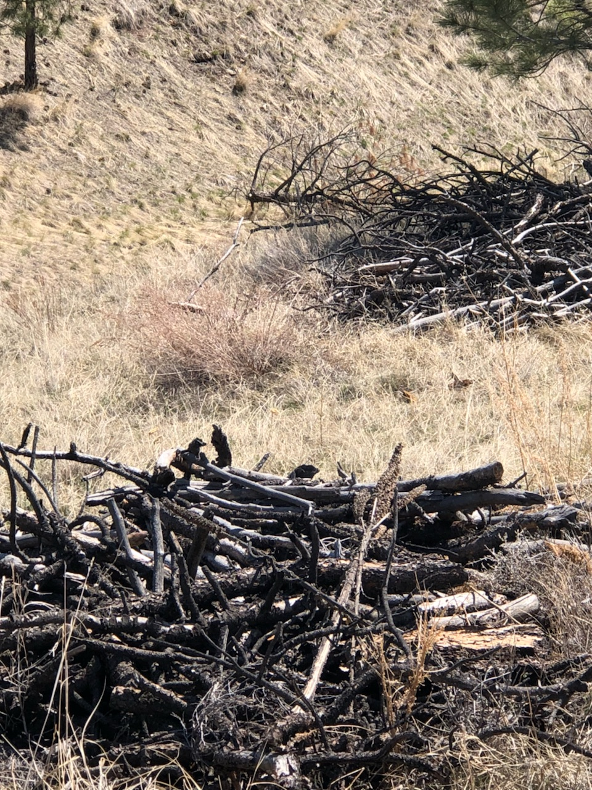
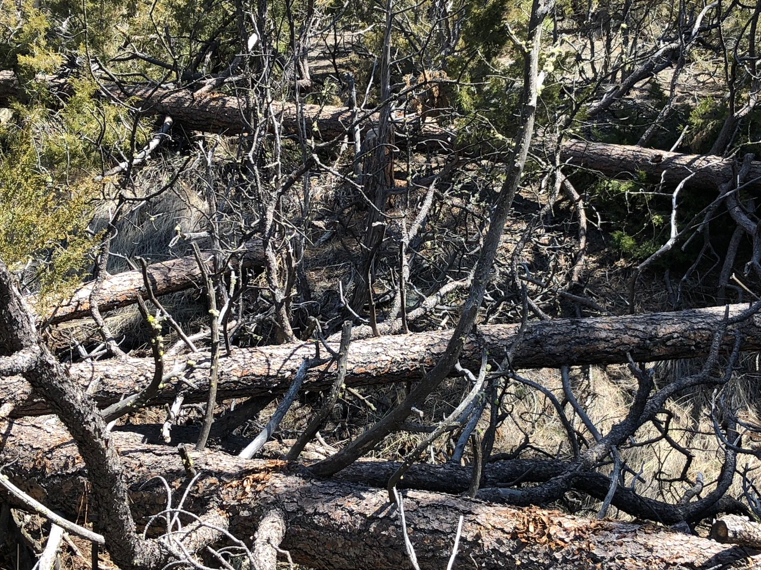
Canyon Ferry Crossing Owners Association Annual Meeting – 2018
Conservation Easement Remediation
37.4 Acres
2018 Fuels Assessment concluded that the easement is a significant fire danger
Assessment concluded past “remediation” contributed to additional fire danger

Slide 22
Canyon Ferry Crossing Owners Association Annual Meeting – 2018
Conservation Easement Remediation
Applied for a USDA Natural Resources Conservation Service (NRCS) Conservation Program Grant
Our grant strategy includes: Fire break, forest stand improvement, tree and shrub pruning, woody residue treatment, brush management, habitat improvement and aesthetics improvement
CFCOA has been found eligible for grant
Grants are pending ranking at this time
CFCOA has not yet been awarded grant
Grant potential is approximately $900 per acre
Not a cost share grant – CFCOA must pay for per-acre difference between grant and actual cost (if there is a difference)

Slide 23
Canyon Ferry Crossing Owners Association Annual Meeting – 2018
Old and New Business
Remaining old business?
2017 annual meeting question: Does the board have insurance to protect the Board in case of lawsuit? “Yes”
Can the fallen trees on the Conservation Easement be chipped and put back on the trail? “Yes”
New business?
- Traditional $1,000 donation to the Tri-Lakes Fire Department

Slide 24
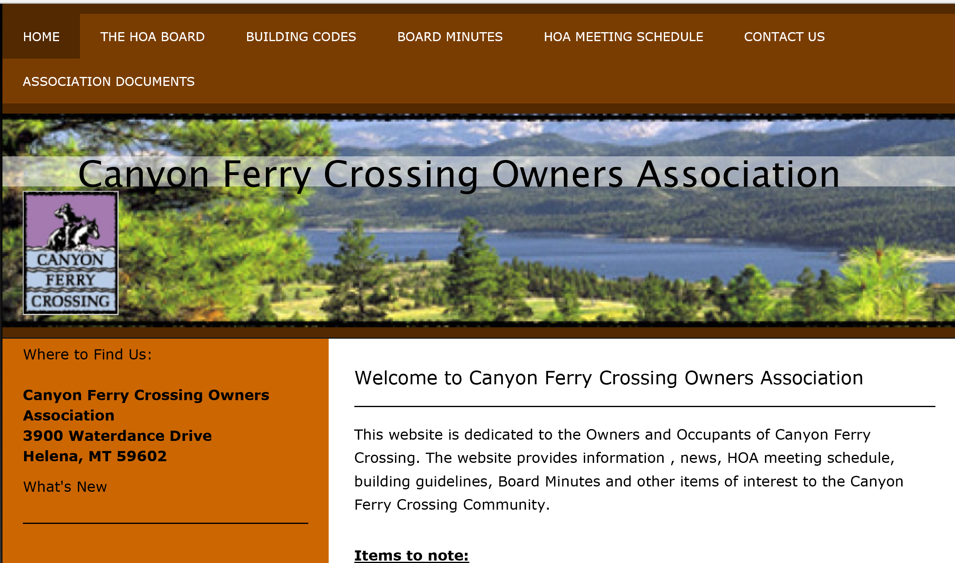
Canyon Ferry Crossing Owners Association Annual Meeting – 2018
Contact Information
Canyon Ferry Crossing Owners Association
3900 Waterdance Drive
Helena, MT 59602
MAILING ADDRESS:
EMAIL:
President: Jim Ybarrondo jimlinybarrondo@yahoo.com
1st Vice President: Mike (Mikey) Clouse maclouse@q.com
Treasurer: Rory McLeod rmcleod4616@msn.com Secretary: (TJ) Theodore Hull theodorehull@msn.com
2nd Vice President: Rodney Kessel rkessel_consulting@hotmail.com
WEBSITE: www.cfcowners.com
Building Codes and ARC
Association Documents
Meeting Minutes
Board Meeting Schedule
Contact Information

Slide 25
Canyon Ferry Crossing Owners Association Annual Meeting – 2018
Adjournment
Move to Adjourn
THANK YOU!

