Slide 1

Canyon Ferry Crossing Owners Association Annual Meeting - 2024
9:00 A.M., Saturday, August 3rd, 2024 Tri Lakes Fire Station Training Room
Welcome!

Slide 2

Canyon Ferry Crossing Owners Association Annual Meeting - 2024
9:00 A.M., Saturday, August 3rd, 2024 Tri Lakes Fire Station Training Room
Please Stand for the Pledge of Allegiance
Welcome!

Slide 3
Canyon Ferry Crossing Owners Association Annual Meeting – 2024
Agenda
Introduction and Welcome
Meeting Rules
Establish a Quorum (call of roll)
Reading of 2023 Meeting Minutes (reading and disposal of minutes)
Board Nominations (election of directors)
2024 Accomplishments
Reports (reports of officers and committees)
Finance Committee
Architectural Review Committee
Maintenance Committee
Unfinished Business (old and new business)
Contact Information
The Way Forward

Slide 4
Canyon Ferry Crossing Owners Association Annual Meeting – 2024
Meeting Rules (Roberts Rules of Order)
1. For the purpose of recognition, a member at Meetings must (1) Stand, (2) Address the Chair as “Mr. or Madame President”, (3) State their name and (4) Proceed to speak only after recognition by the Chair.
2. Debate shall be limited to two (2) minutes for each speaker, except by two-thirds (2/3) consent.
3. Only fully accredited Property owners shall participate directly or indirectly in a vote on any subject
4. Property Owners that are indebted to the Association, in any amount shall not be seated and cannot vote in the Meetings until such indebtedness is cleared.
5. Nominations from the floor at the Annual Home owners Association Meeting can be made at the time of the meeting. Only one nominating speech shall be made for each candidate and shall be limited to two (2) minutes. Seconding speeches shall be limited to two (2) minutes for each candidate. In the event that more than one (1) candidate is nominated for any one office, the written balloting shall continue until one candidate has received a majority of votes cast by the delegates present and voting.
6. Discussion of personal grievances, local conditions, or claims concerning one (1) individual with respect to their personal interest, shall be in order before this meeting, but must be discussed without repeated unprofessional outbursts, name calling, personal attacks or be subject to removal from such meeting.
7. Please be familiar with the Covenance and Bylaws of the association to save time during meetings of the Home owners Association.
8. Open meetings will be conducted, with Minutes taken and posted on the Website.

Slide 5
Canyon Ferry Crossing Owners Association Annual Meeting – 2024
Quorum
CFCOA Bylaws Section 3.9: “Quorum. The presence of twenty-five percent of the Members of the Corporation, represented either in person or by proxy, shall constitute a quorum”
Number of Eligible Members: 130 total, 32 Needed
Number of Members Present:
Number of Proxy Votes:

Slide 6
Canyon Ferry Crossing Owners Association Annual Meeting – 2024
Reading of 2023 Meeting Minutes (1 of 2)
MINUTES OF THE 2023 ANNUAL MEETING OF CANYON FERRY HOMEOWNERS ASSOCIATION
Saturday July 29, 2023
The annual meeting was called to order at 9 a.m. at the Tri-Lakes Fire station. The mail in proxies and the signatures on the sign in sheet (for personal attendance) was tabulated. It was confirmed that a quorum was present either in person or by proxy.
The meeting was opened with the Pledge of Allegiance, led by Rory McLeod.
A motion was made and seconded to forgo the reading of last year’s meetings minutes, (given that they are on the website) and to accept the minutes as presented. The motion passed unanimously.
A motion was made and seconded to approve the actions of the board of directors for the last year’s activities. The motion passed unanimously.
The meeting then proceeded to the election to fill the two (2) board seats, whose term has expired. Lisa Smeaton and Rod Kessel were nominated to fill the seats for the next 2 year term. There were no additional nominations from the floor. Rod Kessel and Lisa Smeaton were elected to the positions unanimously.
Rory McLeod then presented the financial statement for 1/1/21 – 6/1/23. There then ensued a discussion on various aspects of the report. After discussion on any question or comment by a member, a motion was made and unanimously carried, to approve the report as presented.
Fran Hovan, having retired from the ARC committee, was thanked for his many years of service. Lori Young was introduced as the new head of the ARC committee along with continuing members Rod Kessel and Ryan Butler.

Slide 7
Canyon Ferry Crossing Owners Association Annual Meeting – 2024
Reading of 2023 Meeting Minutes (2 of 2)
A long discussion then ensued regarding the building going on in the subdivision. Based on the activity it was shown that the subdivision is about ½ built out.
It was reported that based on the increased building activity the board found it necessary to purchase additional mailboxes. They will be installed on both sides of the main entrance.
Ryan gave a report on the status of maintenance. He further talked about the weed issue and asked all neighbors to police their property. He also addressed the fire that had recently occurred based on lightening strike. He asked all members to be fire aware on their properties. Nathan Bartow (a member of the Tri Lakes Fire Department), then reiterated the fire danger and gave valuable input as to how to be more fire aware on our properties. He also explained the water availability for fire fighting in the neighborhood as well as other aspects of the fire danger situation. All remaining questions/comments on maintenance were addressed.
Thereafter a general discussion ensued on multiple subjects. A key issue was the introduction of the “homeless person” problem in the subdivision. It was asked of all the members to be vigilant on that issue, especially given that many owners are not full time residents.
Each additional issue/question was addressed, as brought up by any member.
The discussion period closed when there were no further questions or comments from the members.
Thereafter, a motion was made and seconded to adjourn. It passed unanimously and the meeting was adjourned.

Slide 8
Canyon Ferry Crossing Owners Association Annual Meeting – 2024
Election of Directors
Board President; Jim Ybarrondo (2 year term)
Board 1st Vice; Ryan Butler (2 year term)
Board Treasurer; Rory McLeod (2 year term)
Nominations from the Floor for the Board?

Slide 9
Canyon Ferry Crossing Owners Association Annual Meeting – 2024
Accomplishments, Initiatives and Course Corrections
Accomplishments and New Initiatives.
Maintained our promise of transparency by posting all meeting dates, locations and minutes on the Association website.
Road Paving on Wilderness Rd
Road Repair on Water Dance Dr
Road repair agreement on contractor construction damage
Converted finance records to quickbook online
Filed Lien on Property for Non Payment of Dues
Signs for No Trespassing

Slide 10


Canyon Ferry Crossing Owners Association Annual Meeting – 2024
Income and Expense Report : Rory McLeod - Treasurer
Income July 1 2023 – June 30 2024 24 23
Architectural Review Fees 5000.00 4500.00
Dues 107,785.15 104,120.45
Late Fees and Charges Assessed 720.00 842.00
Expense
Insurance 3369.00 3136.00
Accounting Fee(quickbook monthly, tax fees and state Registration) 116.91 20.00
Credit Card Fees 30.87 0.00
Arc Expenses 2186.30 3117.50
Legal Fees 5.00 2355.60
Weed Control(noxious weed control and total vegetation spraying) 2500.00 1800.00
Landscape Maintenance(staining and tree work) 80.88 425.00 Road Repairs and Maintenance(paving, road gravel and crack sealing) 500.00 84008.00
Snow Removal 9362.50 11880.00
Website 305.88 218.91
Postage 1053.73 280.73
Misc. Office Supplies 89.60 560.02
Donations ( fire dept.) 2000.00 2000.00
Taxes (easements) 302.21 334.36
Water agreement 500.00 500.00
Utilities 116.31 116.31

Slide 11
Canyon Ferry Crossing Owners Association Annual Meeting – 2024
Income and Expense Report : Rory McLeod - Treasurer
Cash in Bank $39,575
Landscape Deposits being held $26,000
Total cash available $13,575
Road repair and Paving after July 1 $85,973
Home Owners with Dues < 1 Year 18
Home Owners with Dues > 1 Year 4 ( 2 have liens in place)

Slide 12
Canyon Ferry Crossing Owners Association Annual Meeting – 2024
Architectural Review Committee
Lori Young - Lead

Slide 13
Canyon Ferry Crossing Owners Association Annual Meeting – 2024
Maintenance Committee
Reminders:
5.20 Animals. Common domestic pets may be kept on any parcel. No animals, livestock, poultry kept, bred or maintained for commercial purposes. Any animals kept by an Owner must be kept within the boundaries of the Owner’s lot. No pet may be kept which abnormally or unreasonably interferes with the rights, comforts or convenience of other Owners.
Help:
Trimming back trees from protruding on to CFCOA Roads
Please spray or remove all Noxious weeds on your properties

Slide 14
Canyon Ferry Crossing Owners Association Annual Meeting 2024
Maintenance Committee
Projects:
Continue paving and maintenance of roads when we have the funds to do so.
Mowing roadways and trail
Weed Control along roadways and trail
Dog Control

Slide 15
Canyon Ferry Crossing Owners Association Annual Meeting – 2024
Old and New Business
Remaining old business?
New business?

Slide 16
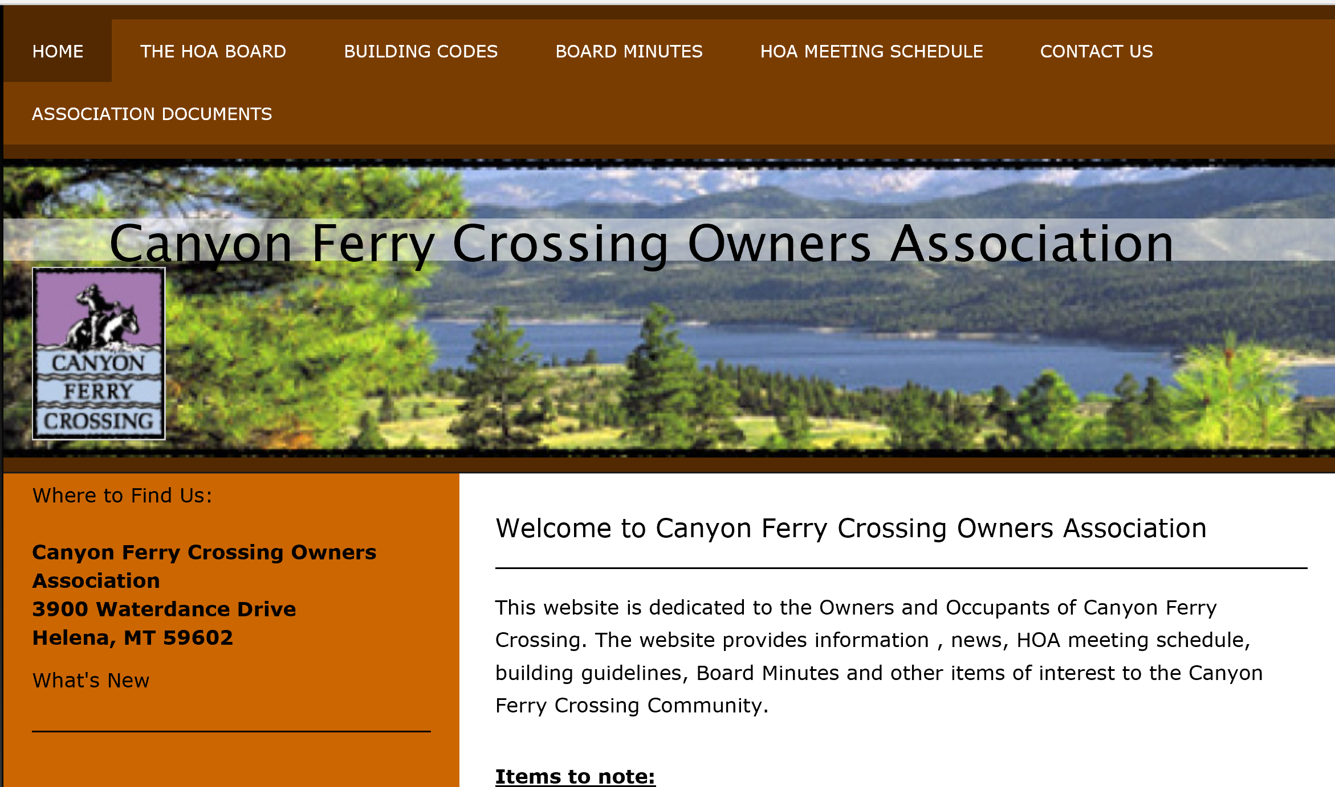
Canyon Ferry Crossing Owners Association Annual Meeting – 2024
Contact Information
Canyon Ferry Crossing Owners Association
3900 Waterdance Drive
Helena, MT 59602
MAILING ADDRESS:
EMAIL:
President: Jim Ybarrondo jimlinybarrondo@yahoo.com
1st Vice President: Ryan Butler wrbutler82@hotmail.com
Treasurer: Rory McLeod rmcleod4616@msn.com Secretary: Lisa Smeaton lisann715@mt.net
2nd Vice President: Rodney Kessel rkessel_consulting@hotmail.com
WEBSITE: www.cfcowners.com
Building Codes and ARC
Association Documents
Meeting Minutes
Board Meeting Schedule
Contact Information

Slide 17
Canyon Ferry Crossing Owners Association Annual Meeting – 2024
Adjournment
Move to Adjourn
THANK YOU!

